Slide 1
Origins…
A study of the scientific and literary support for the creation story

Slide 2
“In the beginning God created the heavens and the earth.”
- Genesis 1:1

Slide 3
Goals for the next month
Evaluate nature through the eyes of Scripture, and also through the eyes of nature itself to determine if there is any evidence for God.
Evaluate the first few chapters of Genesis – specifically the creation and flood stories – to determine if they originated by God.
Pursuing these goals means there may be large stretches in which we will not be studying a significant amount of Scripture.

Slide 4
Purpose
“Why spend an entire month talking about a short section of the Bible which contains little to no information regarding our salvation?”
How we interpret the first eight chapters of Genesis directly impacts how we interpret the rest of Scriptures
Our beliefs regarding the origin of the earth, and the universe, have a direct impact upon how we view the world
The first eight chapters of Genesis are those which are most contested by the academic world and our atheistic friends
We need to convince ourselves with sound reasoning before we will be able to answer those who ask us a reason for our convictions

Slide 5
Three founding principles
The Bible is a message directly given to humans from God
2 Timothy 3:15-16
2 Peter 1:19-21
1 Peter 1:25
When God speaks, he speaks the truth – even when we do not fully understand the matter
Romans 3:4
“Truth agrees with truth”
Each person is responsible for evaluating all matters of faith, responsible for making up their own mind, and responsible for taking ownership of these decisions
Acts 17:11
Philippians 2:12

Slide 6
Creation originated with God
The Bible has been consistent from the Old Testament through the New Testament regarding how the world came to exist
Genesis 1:1 – “In the beginning God created the heavens and the earth.”
Exodus 20:11 – “For in six days the LORD made heaven and earth, the sea, and all that is in them”
Job 38:4 – “Where were you when I laid the foundation of the earth? Tell me, if you have understanding. ”
Psalm 33:6 – “By the word of the LORD the heavens were made, and by the breath of his mouth all their host.”
Hebrews 11:3 – “By faith we understand that the universe was created by the word of God, so that what is seen was not made out of things that are visible.”
II Peter 3:5 – “For they deliberately overlook this fact, that the heavens existed long ago, and the earth was formed out of water and through water by the word of God”

Slide 7
What does this mean?
When something is created, the “creator” always has a purpose behind what is created and why it is created
If there is a creator and a purpose behind the creation, it seems reasonable for us to be able to “find” the creator and the purpose of the creation

Slide 8
A matter of faith
Believing in God as the Creator of this universe is a matter of faith and as a matter of faith, we should caution against attempts to “prove” creation through science.
Hebrews 11:1, 3 – “Now faith is the substance of things hoped for and the evidence of things not seen…By faith we understand that the universe was created by the word of God, so that what is seen was not made out of things that are visible.”
“substance” – essence, confidence, assurance
“evidence” – conviction
Is there anything which helps guide our faith? Is there any evidence?

Slide 9
A story about a watch

Slide 10
A watchmaker…a Creator
For William Paley, when he saw a watch he knew there had to be a watchmaker as its originator. When he saw the world with it’s complexity which exceeded that of a watch a thousand times over, he knew there had to be a creator as its originator.
The “design argument” – Paley’s “watchmaker” argument – is not only a logically sound argument for the existence of a Creator, but it also a biblical argument for a Creator.

Slide 11
Biblical purpose of nature
When it comes to nature – the world below, around, and above us – the Scriptures have maintained a consistent message as to the purpose of nature:
Psalm 19:1-6 and Psalm 148
Acts 14:17 – “Yet he did not leave himself without witness, for he did good by giving you rains from heaven and fruitful seasons, satisfying your hearts with food and gladness.”
Romans 1:20 – “For his invisible attributes, namely, his eternal power and divine nature, have been clearly perceived, ever since the creation of the world, in the things that have been made. So they are without excuse. ”

Slide 12
God’s handiwork
The Bible contains God’s confession – a confession that God created the earth in a specified time period and in a specific means.
Nature is the evidence to support God’s confession. Nature serves as a resounding and irrefutable witness to the existence of a mighty Creator of the universe.

Slide 13
An interesting find
Romans 2:14-15 – “For when Gentiles, who do not have the law, by nature do what the law requires, they are a law to themselves, even though they do not have the law. They show that the work of the law is written on their hearts, while their conscience also bears witness, and their conflicting thoughts accuse or even excuse them.”

Slide 14
An interesting find
Scientists have found that children are “intuitive theists” regardless of their religious upbringing
“By elementary-school age, children start to invoke an ultimate God-like designer to explain the complexity of the world around them – even children brought up by atheists.” (Dr. Alison Gopnik, Wall Street Journal column)
“Even though advanced scientific training can reduce acceptance of scientifically inaccurate [purposed-based] explanations, it cannot erase a tenacious early-emerging human tendency to find purpose in nature.” (Dr. Deborah Kelemen)

Slide 15
Biologists (kind of) acknowledge design
“Biology is the study of complicated things that give the appearance of having been designed for a purpose.”
- Richard Dawkins (present day neo-Darwinist)
“Biologists must constantly keep in mind that what they see what not designed, but rather evolved.”
- Sir Francis Crick (co-discoverer of the DNA structure)

Slide 16
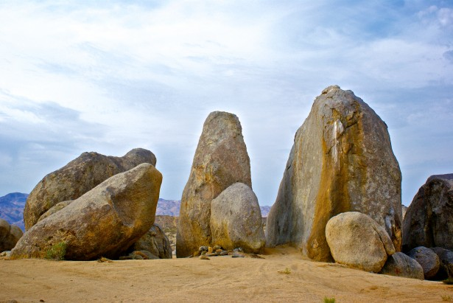
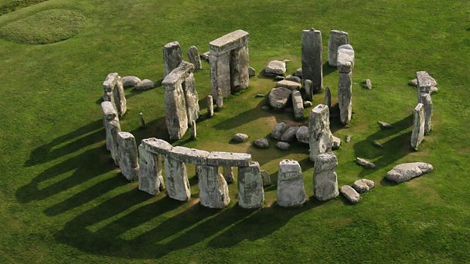
Recognizing when something is designed
People have said you can’t define art. You’ll know it when you see it. Design is the same way. We know when something has been designed.

Slide 17
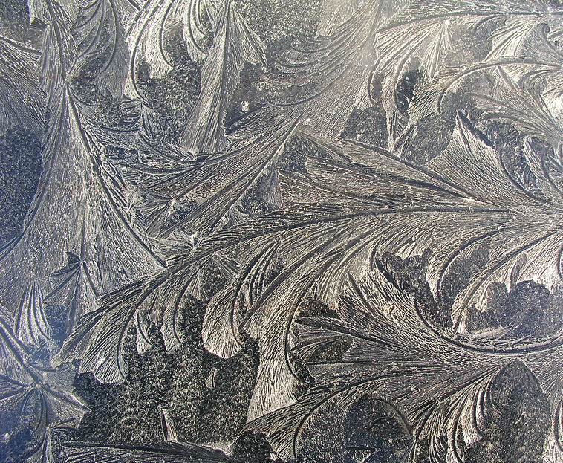
Power supply and a frost pattern

Slide 18
More than just complexity
Specified – complexity which conforms to a repeatable pattern
Functional – complexity which has a purpose and performs a function

Slide 20
Human metabolic pathway
And this is just the beginning

Slide 21
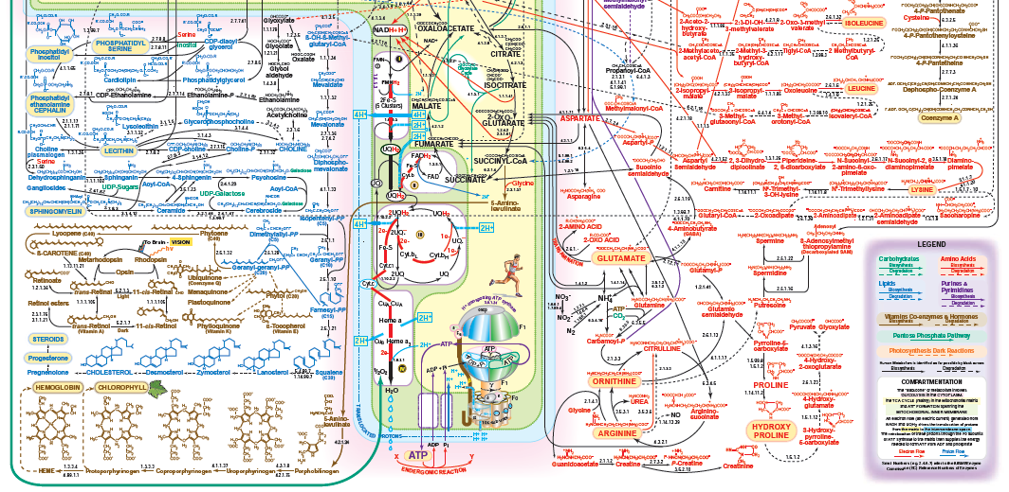

Slide 22
Another way
There’s also another way of recognizing design – when humans create something and then later on find something in nature which looks and acts just like it.
We know the first was designed – it originated in the mind of someone for a specific purpose.
An idea became reality.
We then see the same “design” in nature and should also come to the same conclusion.

Slide 23
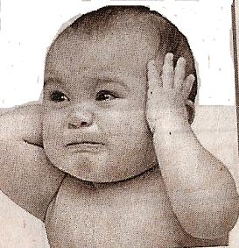
Oh no. Anything but science!

Slide 24
Exhibit 1A – the rotary motor

Slide 25
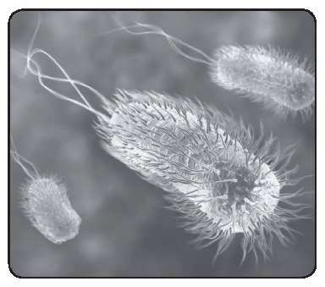
Exhibit 1B – Bacteria flagella (what?)

Slide 26
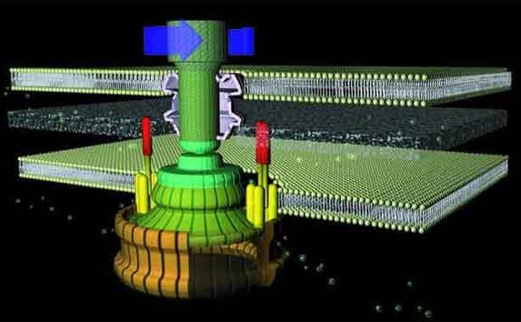
Exhibit 1B – Flagella motor

Slide 27
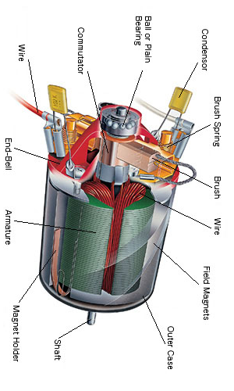
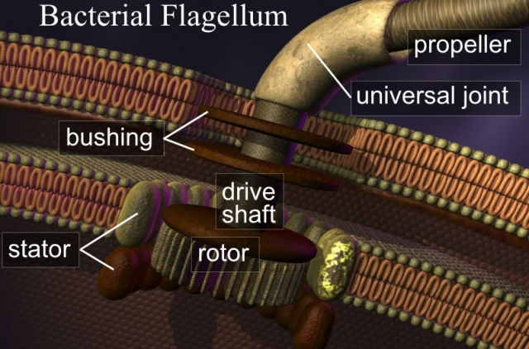
Exhibit 1B – Flagella motor

Slide 28
Exhibit 2A – multi-ply rope
Z
S

Slide 29
Exhibit 2B – Hair (e.g., keratin)

Slide 30
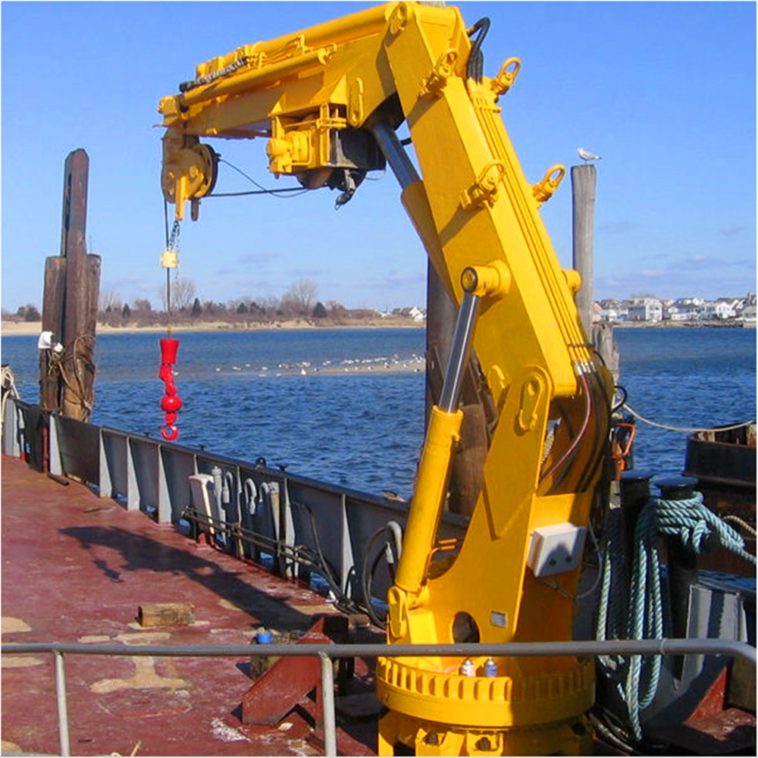
Exhibit 3A – hydraulic crane arms
Hydraulics – using pressurized liquids in a sealed system to do work
Has been used since late 1700’s
First applied to cranes in late 1880’s
First true hydraulic crane manufactured in 1948 but the technology of hydraulics was being used elsewhere

Slide 31
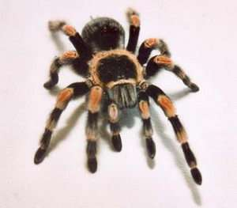
Exhibit 3B – spider legs
A hydraulic system was proposed in 1944 for how spider legs work. This was confirmed in 1959. Muscles contract the legs, hydraulics extend the legs.

Slide 32
Brief review
“How did we get here?” is the most important question we need to address in our lives.
The message of the Bible is consistent – God spoke the world and all that is in it into existence.
Nature is meant to magnify God and act as a witness to His existence and characteristics.
Our intuition from our youth is the world was designed for a purpose
We can see evidence of God’s design when nature mimics something humans made

Slide 33
Recognizing when something is designed

Slide 34
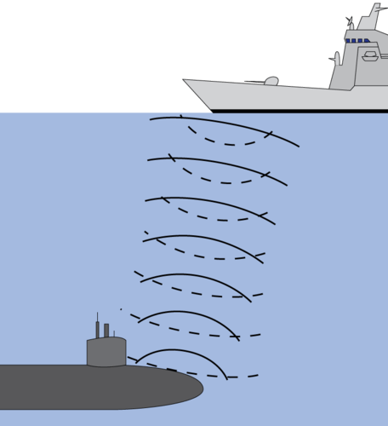
Exhibit 4A – Sonar to locate submarines
Sonar is the use of sound waves in water to locate an object’s position
First sonar developed in 1906 to detect ice-bergs
First sonar to detect submarines invented in 1915
Extensively used in WWII

Slide 35
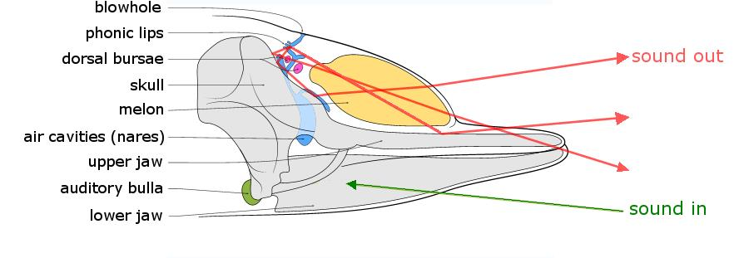
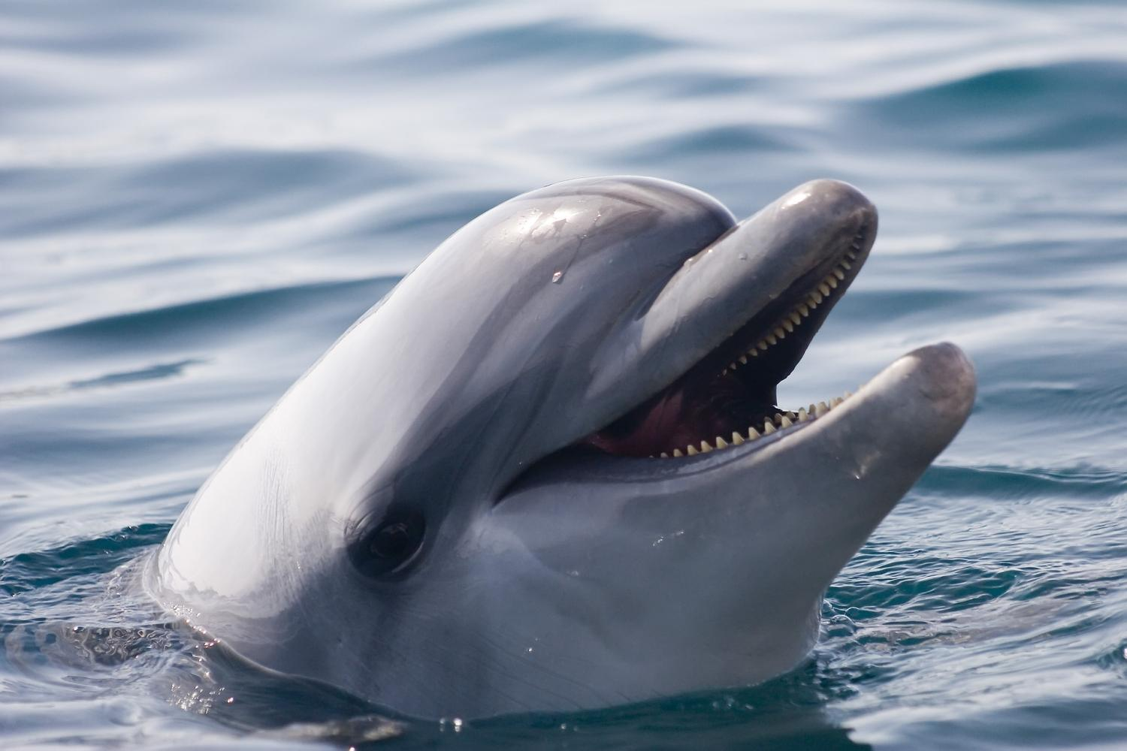
Exhibit 4B – dolphins and echolocation
Although proposed in 1947, it wasn’t until 1960 that it was confirmed dolphins and other related whales use a bio-form of sonar for ecolocation of prey and terrain.

Slide 36
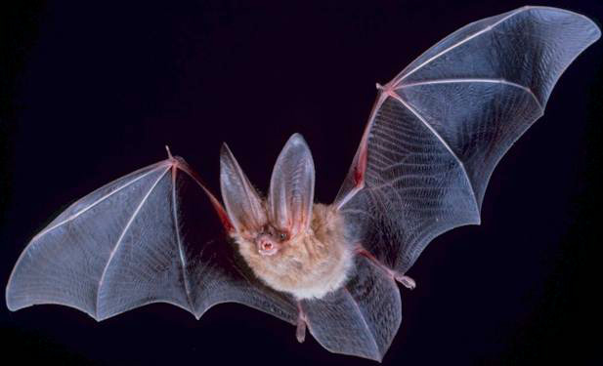
Exhibit 4C – bats and echolocation
In 1938 it was discovered that bats use ultrasound (sound outside the range of human hearing) to detect prey and other objects in total darkness.
Doppler shift effect of sound waves and moving objects

Slide 37
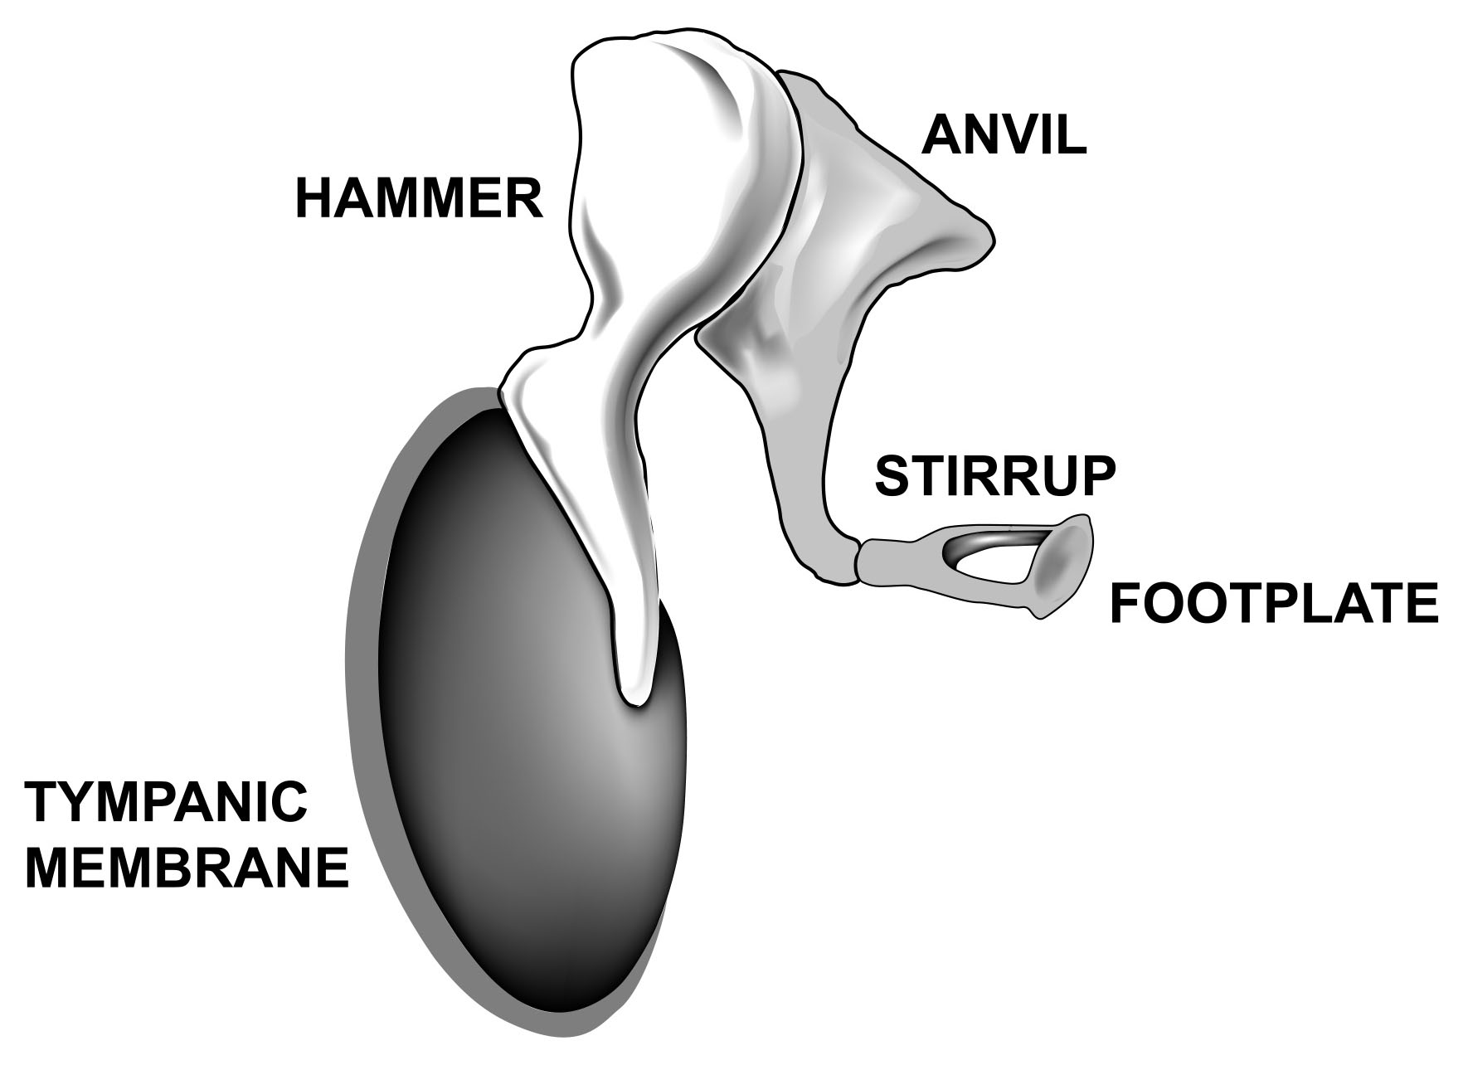
Exhibit 4C – bats and echolocation
Sound can come out of the mouth – or the nose
Bats can interpret the echoes to determine location, directionality, and shape of objects
Ears have a special protective feature

Slide 38
1st century Greek historian Plutarch
“But can it be that those things which are most important and most essential for happiness do not call for intelligence, nor have any part in the processes of reason and forethought? Nobody wets clay with water and leaves it, assuming that by chance and accidentally there will be bricks, nor after providing himself with wool and leather does he sit down with a prayer to Chance that they turn into a cloak and shoes for him.”

Slide 39
Intro to evolutionary theory
Began in 1859 when Charles Darwin of England published On the Origin of Species. Followed by Of the Descent of Man which was published in 1871.
Evolution, referred to as “neo-Darwinism” today, has it’s roots in these two books.
The general theory is all living organisms today – regardless of current complexity or appearance – can be traced back to a single common ancestor

Slide 40
Began with some birds

Slide 41
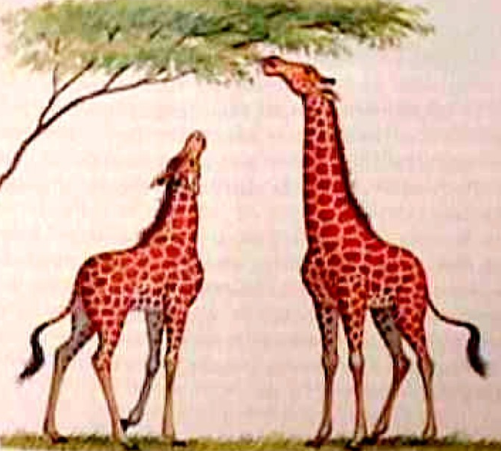
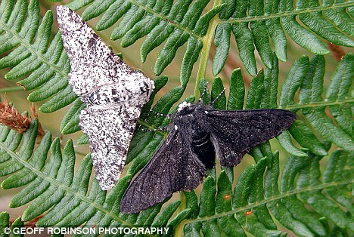
Adaptation
Two central principles
Descent with modification
Survival of the fittest (“natural selection”)

Slide 42
Some important points
All living organisms today are simply links in a chain of creatures constantly morphing from one from into another.
The changes must be gradual
Only features which are passed on to off-spring factor in to evolution
The entire process is random and completely unguided (The Blind Watchmaker)

Slide 43
No room for God
Modern science follows the path of Darwin to seek explanations for the world around us, including our origins, in completely “naturalistic” means
Only explanations which can be explained using natural laws and processes of science are allowed
Explanations which do not follow natural laws are not allowed – “supernatural”
“God” is not even allowed into the discussion

Slide 44
Why is this so popular?
The vast majority of scientists feel evolution is beyond dispute?
A large percentage of non-scientists freely accept this belief. Why?
Frees the conscience
Feel “unqualified” to reason about science.
Remember, false teaching can be presented in a very persuasive manner if we have no love for the truth.
“The coming of the lawless one is by the activity of Satan with all power and false signs and wonders, and with all wicked deception for those who are perishing, because they refused to love the truth and so be saved. Therefore God sends them a strong delusion, so that they may believe what is false, in order that all may be condemned who did not believe the truth but had pleasure in unrighteousness.”
- II Thessalonians 2:9-12

Slide 45
Going back to children
Previously discussed how children have been found to be “intuitive theists” when it comes to nature and a Creator.
“But God chose what is foolish in the world to shame the wise; God chose what is weak in the world to shame the strong; God chose what is low and despised in the world, even things that are not, to bring to nothing things that are, so that no human being might boast in the presence of God.”
- I Corinthians 1:27-29

Slide 46
Quick thoughts
If only looking at physical features seen with unaided eye, this approach could make sense.
Our own selective breeding of animals targets desirable features
Animals could be arranged in a way which appears to show a progression of forms
But even then, this idea is completely contrary to our own intuition and how people have naturally viewed the world for millennia.

Slide 47
The problem of looking too close
As our knowledge base increases, this theory becomes more challenging
Complexity dramatically increases as we look closer and closer
We now understand, at least partially, the specific mechanisms which are behind all physical features of any living creature whether plant, animal, bacteria, or virus.
Darwin could only see so far. He didn’t know what he didn’t know.

Slide 48
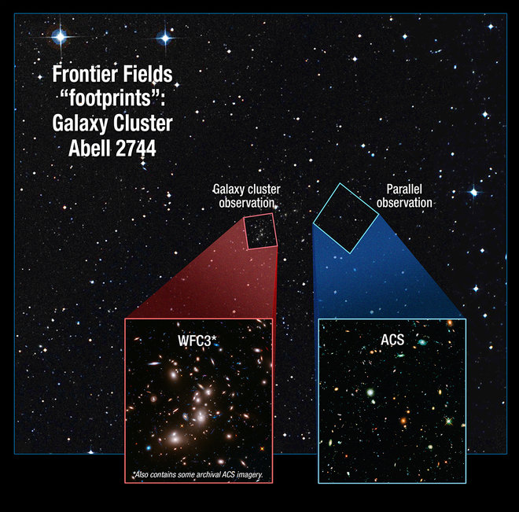
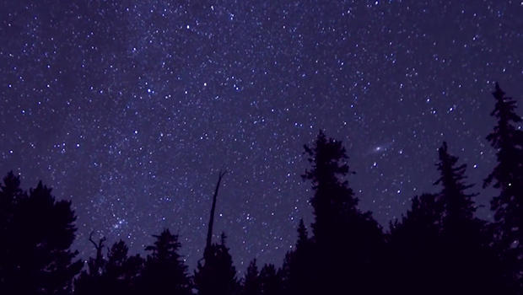
What we see when we look closer

Slide 49
Before we start
Use your intuition as we take closer and closer looks at the human body
Does it make intuitive sense for these features to be the results of natural, unguided processes?
Does it pass the smell test?
Do these features leave us “without excuse” there is a Creator?

Slide 50
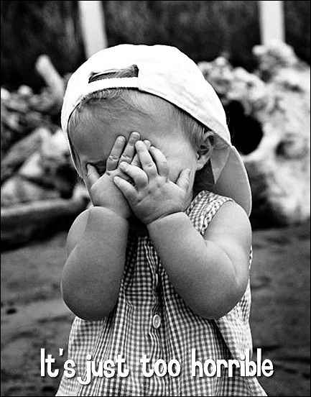
Bear with me a bit
This next section is going to get a bit technical
The purpose is to see marvelous the works of God within our body
The various terms aren’t important
Just focus on the complexity of the various layers
Science is fun, right? ☺

Slide 51
David saw God in the human body
“For you formed my inward parts; you knitted me together in my mother's womb. I praise you, for I am fearfully and wonderfully made. Wonderful are your works; my soul knows it very well”
Psalm 139:13-14
But we know more than David today about how we are “fearfully and wonderfully made” by God.

Slide 52
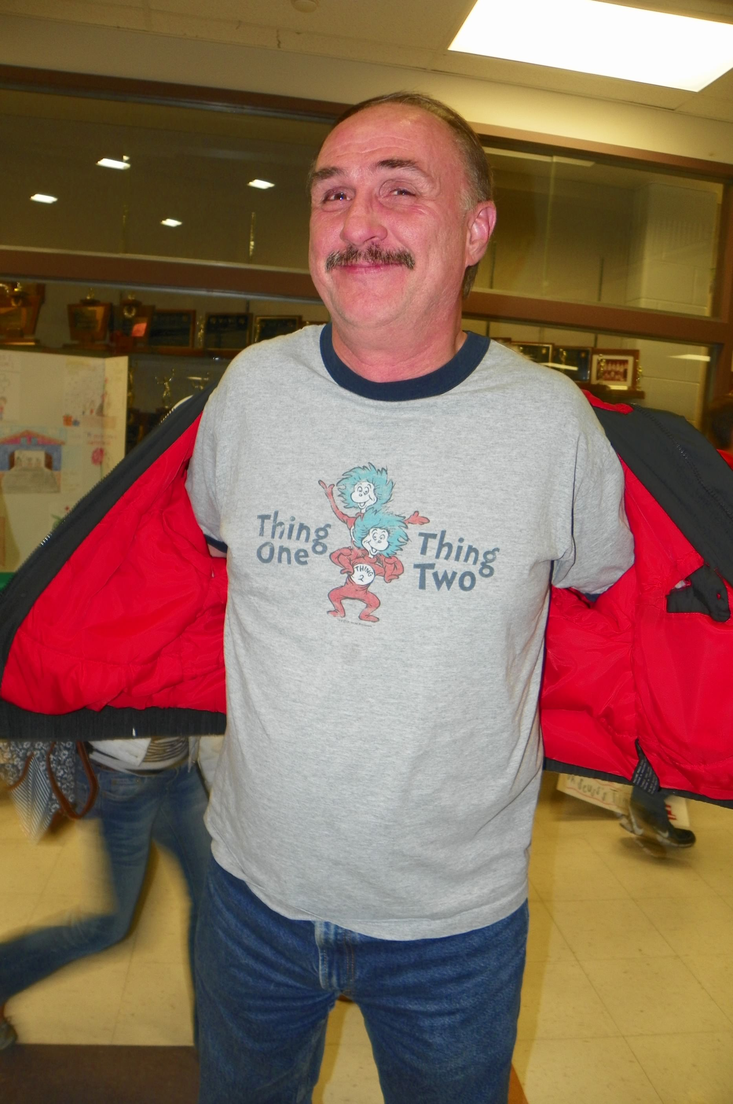
The human body
About 78 different organs comprising 11 different major systems
Skeletal system typically has 206 bones
Muscular system has about 640 named muscles
Estimated to have 37 trillion different cells
Current life expectancy is 79 years
Heart would beat over 3.3 billion times
Take over 660 million breaths

Slide 53
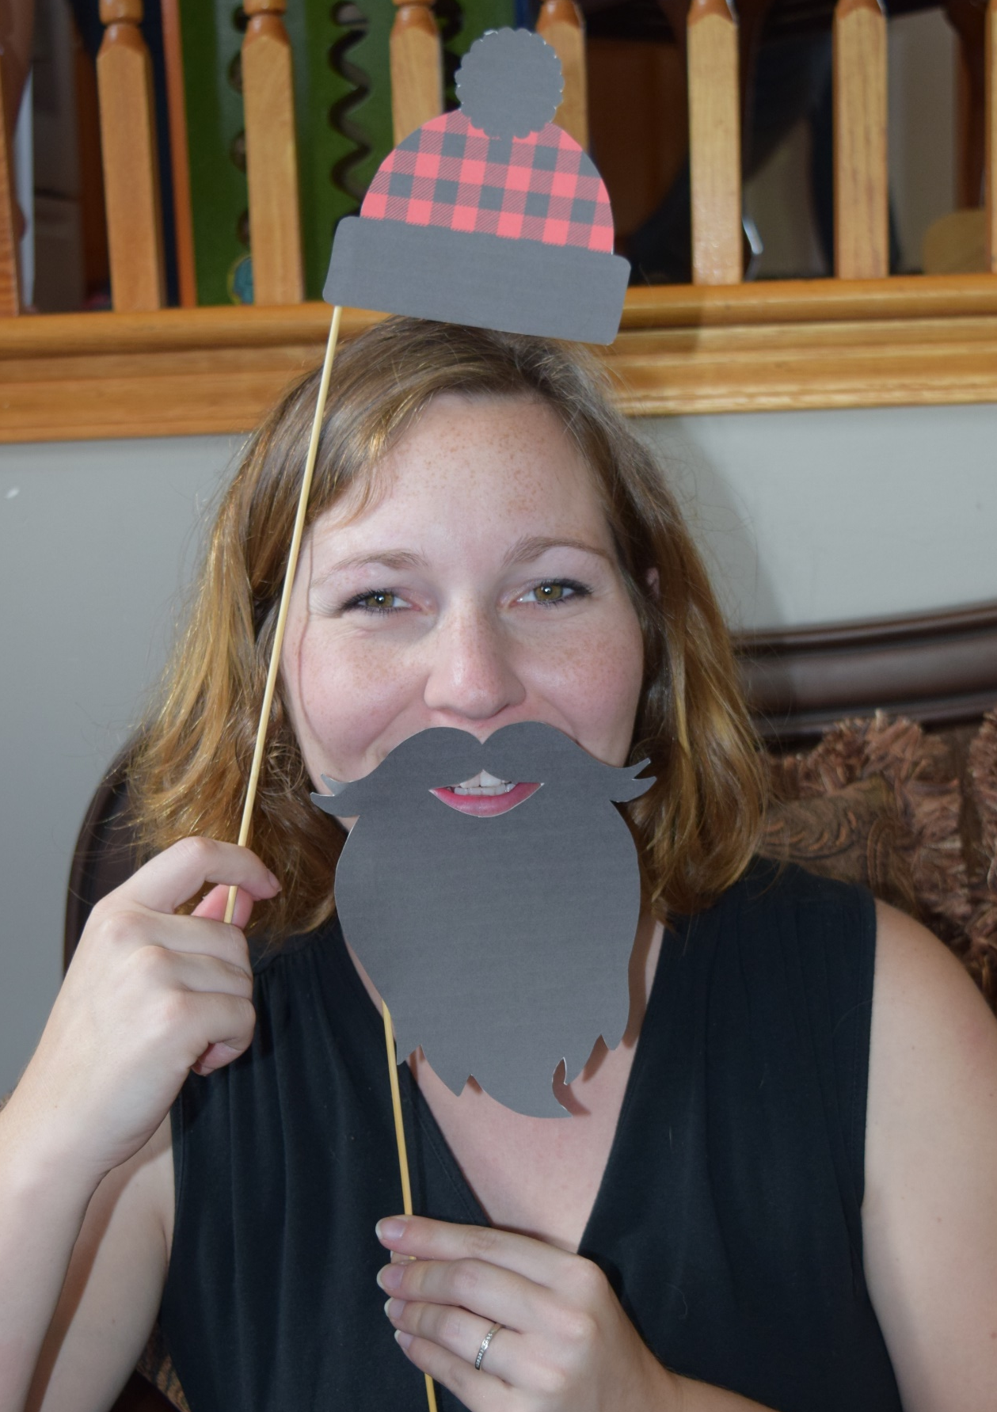
The human body
Amazing facts about the human body:
Human brain runs on just 20 watts of power (dim light bulb), similar to power in typical laptops; however…
It took 82,000 processors in a supercomputer to mimic what the brain can do in just 1 second
Bone is five times stronger than a steel bar of the same width
The body cools itself through the evaporation of sweat to avoid overheating
An infant lives surrounded by water without taking a breath to instantly breathing at birth
Bones in an infant’s head are not connected, allowing them to overlap during birth before fusing together into a protective skull after birth

Slide 54
The human body
The amazing facts about the human body are virtually endless.
Even a basic understanding of the human body creates a convincing argument for design
As we dive deeper and deeper into the human body, specifically, the workings of the human cell, we find some of the most powerful evidence for a Creator behind it all.

Slide 55
Looking closer – circulatory system
Red – arteries (vessels taking blood away from the heart
Blue – veins (vessels taking blood towards the heart)
In an adult human body, there are 100,000 miles of blood vessels.

Slide 56
Looking closer – blood vessels

Slide 57
Looking closer – blood composition

Slide 58
Looking closer – different cell types
There are over 200 different types of cells in the human body.
Each cell has a specific structure and performs a specific function.

Slide 59
Looking closer – the human cell

Slide 60
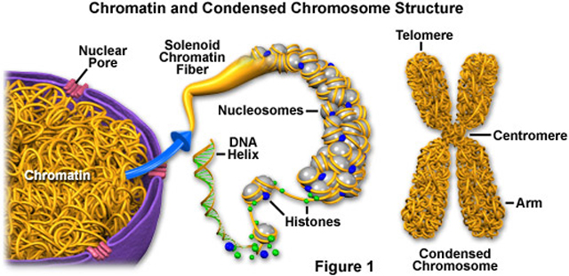
Looking closer – inside the nucleus

Slide 61
Looking closer - DNA

Slide 62
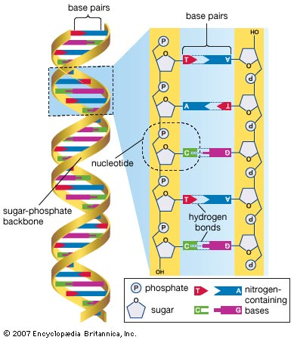
The role of DNA
Virtually everything about our physical bodies is controlled by our DNA
Physical features like eye and hair colors
Organ development
Metabolic processes after we eat food
How our bodies experiences “senses”
DNA is the complex language of life where information is stored by the non-repeating arrangement of four different compounds.
Every cell containing a nucleus, regardless of the tissue type, has the exact same DNA.

Slide 63
But there’s something else
DNA is the source of information for a cell. It is not the source of action for a cell. All of the “work” within a cell is done by something different – enzymes.
Enzymes (proteins) do the work necessary for life.
Building tissue components
Breaking down tissue components
Digesting food
Eliminating waste
Healing wounds
Transmitting messages within the body

Slide 64
What makes up these little workers?
Active site
Enzyme
Amino acids – individual building blocks within the structure

Slide 65
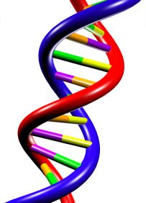
Going from here to there
?
DNA
Enzyme

Slide 66
Design example 5A - language

Slide 67
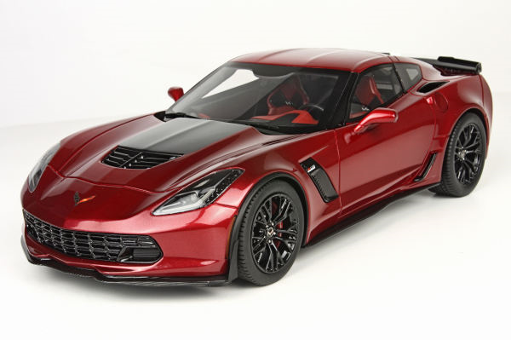
What is language?
The method of human communication consisting of the use of words in a structured and conventional way
Either spoken or written
Within a community of individuals

Slide 68
Characteristics of language
Individual entities within language (“words”) have meaning
Specific and consistent → Understood by the sender and the receiver
The sequence of elements within words (“letters”) must remain unchanged for the meaning to remain unchanged
Tea, eat, ate
“Cheating is not allow.” → “Cheating is now allowed.”
The world of possible elements (“letter”) is limited for a given language.
“WALKING” – “ΣALKIɊG”
Other rules of grammar affect meaning.
“Let’s eat, Grandma.” → “Let’s eat Grandma.”

Slide 69
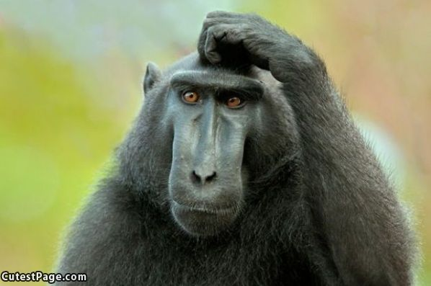
Language (or info) from randomness?

Slide 70
Can randomness create words?
kpmic sfkwr cddjb rpnpn doeaf yzckx dwaue iotju uuhmx lbcon dcqvb nbhdh nbjtn bynjo tzxiu nvqco rnkpn asqgm eqxmy qcfab nbugd pvuvt lcuwn pkuwo omjmy oyesa pupwh itoes viffx cpyga wukyz refpb esxiw rwofl lsibr dklbn ppauj bjcps qcubk ecizr minzk jbgve rwrfw mgbre cilfq ichit qtsgi augfu olkox vdvdw pallm uevhw cfedt ivzko zxyjw jrthi vspkd oedwn nfrbk dnieq bdjrt iuzkt gimle hxfwn aapbu jvkxg gigti tpisu ooicl vqnfe behqf cmchy ommjo rpyvc hdnkj lqdor acamw vjofk wiqxo kvavf tugmy ghmrx ngudk ukwpj fgtyt hamda azuni gbrup rfsgb blctt uhear sfglv ktcje tqmro csdvj qpjzg mlzna wqbsa hkwww dseac
- 100 random combinations of five letter arrangements

Slide 71
Can randomness create words?
wom ycb sjr zgb zcr fdw myb txg kva mbq icr ilf ohz oru keo wau qpb faz uke jsi sqs lai pia kzx swq rcv uub zqk wjx xpx atb nsr asl gpu jkc plh kzz uhj jqt roe npa stq dbl qtr xiv gcc ert xhs mve omw jls jsy fdk bpj xrr vyx cgr ake fer rvy qvm qlk ogr hby cop vln utv kjw rlc mgk fgt vai mpb zwc poh ovk dcf oxu peg nqh uqy mwr uhi sro ybo lqc aap mbn scz rnt kfl mfm kwk tpd ysl eqg phq gup xkm zhn
- 100 random combinations of three letter arrangements

Slide 72
Boggle at the Morris home
ure glurt gurt nort fac hac cun boco laft fait cait cail hait ment catn saten sut tas coe bune cas tuc tucs suc sucs cune entt soco voco boe jober eiw bue buer vue sode bew buier dob hed heds

Slide 73
What if we started with real words?
Optimize rob plot wren breakfast scale correspond billowy gullible real hate bustling lie leak efficacious.
Limp past believe cover four melted sew prosecute alert spot crooked strive contradict break threatening.
Shame dream vanish assert impart face innovate skid sad plant leather boil damaged greasy stereotyped.
Tightfisted camp encourage contradict corrode handsome squeamish faucet bent sprout bewildered wish elderly dedicate sincere.
Offset book balance highfalutin course solicit dress bomb sweet frighten lean rambunctious obtain development practice.

Slide 74
What does this mean?
Language has rules which must be obeyed in order for the “language” to impart a meaning.
Combinations of letters only produce meaningful words if that combination was already assigned, and recognized
The meaning and intent come before the word.
The longer the length, the less likely it is to randomly generate a meaningful word
Word order and sentences have rules of logic and syntax
Ultimately this means language can only exist when there is intelligence behind the creator of the language.

Slide 75
An important aspect of language
00100010 01001001 01101110 00100000 01110100 01101000 01100101 00100000 01100010 01100101 01100111 01101001 01101110 01101110 01101001 01101110 01100111 00100000 01000111 01101111 01100100 00100000 01110100 01101000 01100101 00100000 01101000 01100101 01100001 01110110 01100101 01101110 01110011 00100000 01100001 01101110 01100100 00100000 01110100 01101000 01100101 00100000 01100101 01100001 01110010 01110100 01101000 00101110 00100010
“In the beginning God created the heavens and the earth.”
Translation of languages also requires intelligence.

Slide 76
But what’s the point?
?
DNA and enzymes are both languages – but different languages
DNA
Enzyme
What does this mean then?

Slide 77
Design example 5B - language
If DNA and enzymes are examples of true and distinct languages, then:
The sequence of individual components within DNA has a meaning which is also understood by enzymes
The actual sequence of individual components within these languages is essential to retain the same message
Essential for the “words”
Essential for the “sentences”
Other “grammar rules” also apply
The “message” is the “work” which is done by the enzymes
If the “message” changes then the “work” doesn’t get done
If DNA and enzymes are languages, then they must have originated from an intelligent source

Slide 78
Going from the message to the work

Slide 79
Language of DNA – transcription

Slide 80
Language of DNA - transcription

Slide 81
DNA to enzymes – language translation

Slide 82
Language of enzymes – making it work

Slide 83
Changing the “message”
At the most fundamental level, evolutionary theory requires random changes in the message (individual “rungs” in the DNA “ladder”) to create a new message which is understandable, functional, and better.
“Cheating is not allowed.”
“Cheating is now allowed.”
“Cheating was not allowed.”
“Heating is not allowed.”
Cheatzng is not allowed.”
How likely are random changes to a functional message likely to result in another functional message?

Slide 84
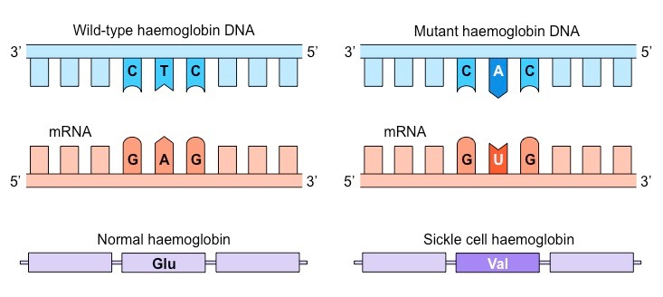
Mutations
Random changes in the DNA are called mutations – and the vast majority of them are harmful

Slide 85
Finally done with the technical part!

Slide 86
We see God’s design in our bodies
“For you formed my inward parts; you knitted me together in my mother's womb. I praise you, for I am fearfully and wonderfully made. Wonderful are your works; my soul knows it very well”
Psalm 139:13-14

Slide 87
A reminder about evolution
All living organisms today are simply links in a chain of creatures constantly morphing from one from into another. (descent with modification)
The changes must be gradual
Only features which are passed onto off-spring that provide an advantage will continue on (survival of the fittest)
The entire process is random and completely unguided

Slide 88
DNA and a dolphin’s echolocation
Every thing here is guided by DNA and according to evolution, just happened, independently, over the course of time.

Slide 89
Of bacteria and bugs
Scientists have been studying two organisms for decades to help better understand the effect of DNA mutations on function and appearance
Escherichia coli (E. coli) – can reproduce in 20 minutes under the right conditions
Drosophila melanogaster (fruit fly) – life span is about 40-50 days and a female can lay up to 1,000 eggs
Genetics of both are well known and have been subjected to every possible mutation device known to humanity

Slide 90
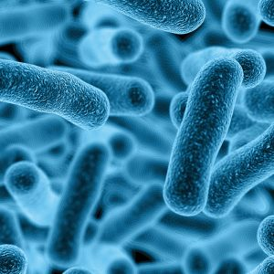
What have E. coli mutations created?
Long term evolution experiment by Michigan State University professor Richard Lenski
Started in 1988
In August 2016, there had been 65,000 generations of E. coli
The result?
They started with single celled E. coli bacteria and currently still have single celled E. coli bacteria
The same number of generations in humans would equate to ~1.3 million years

Slide 91
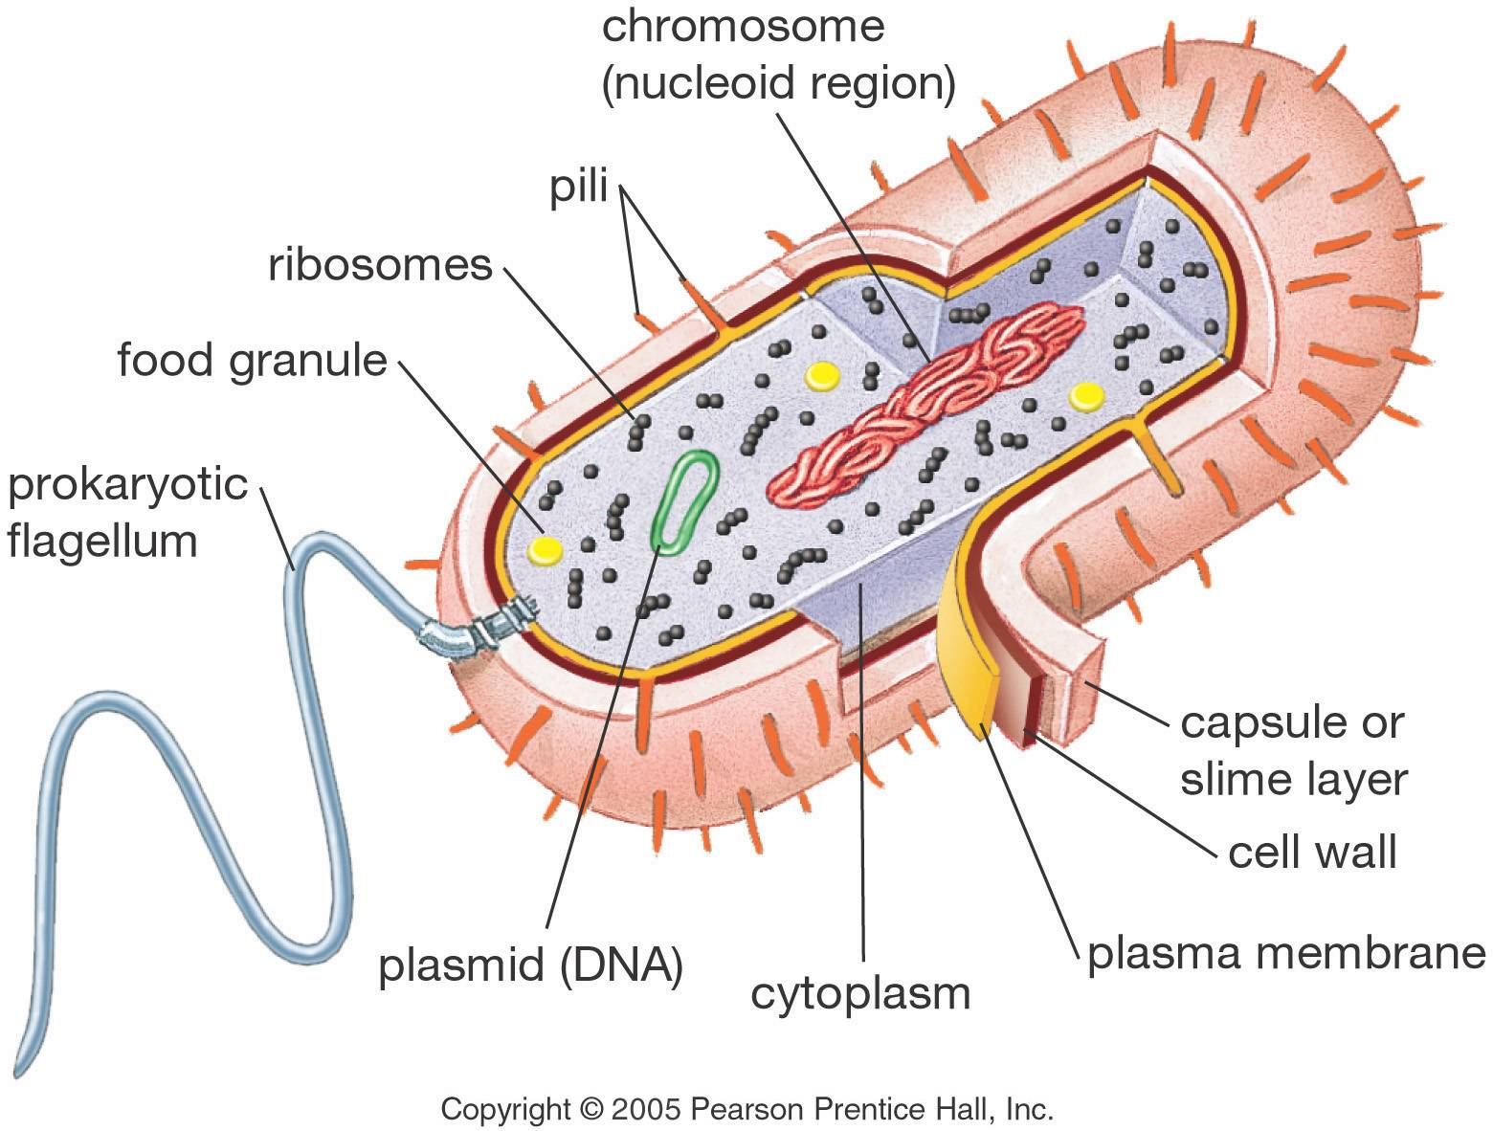
What hasn’t happened

Slide 92
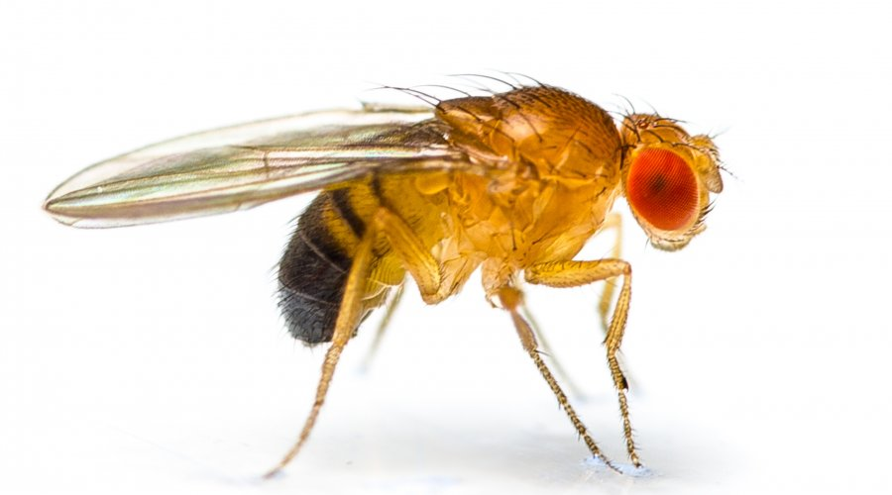
What have fruit fly mutations created?
Fruit flies are multi-cellular and have the potential for mutations to create different visible parts. They have been subjected to virtually everything we know which causes mutations in DNA.
The result?
They started with fruit flies and now have – just fruit flies
Admittedly, some of these flies are pretty weird

Slide 93
Bringing it all together
“Biology is the study of complicated things that give the appearance of having been designed for a purpose.”
- Richard Dawkins (present day neo-Darwinist)
All of life, from what we can see with just our eyes to the complexities of DNA, can only be explained by the presence of a higher power and designer behind it all.
Evolution is wholly incapable of explaining even the simplest life form.

Slide 94
But there’s another story from DNA

Slide 95
A bit more about DNA and mutations

Slide 96
Mitochondrial DNA
Only get it from your mother.
All children from the same woman (regardless of gender) share the exact same copies of mitrochondrial DNA
But not everyone share the same mitochondrial DNA
Minor changes have occurred over time
Scientists have attempted to use these changes to link different nationalities and create a “mitochondrial DNA family tree”
What they’ve done is been able to see how people migrated over time
Scientists also believe mitochondrial DNA shows humanity went through a genetic “bottleneck” at one point and was near extinction.

Slide 97
The mitochondrial DNA map

Slide 98
A bit about Africa
The mitochondrial DNA map shows humans coming out of Africa, not the middle East.
Long before the mitochondrial map was put together, scientists had already determined humans emerged out of deep Africa hundreds of thousands of years ago.
Every other study of human migration is based upon this underlying assumption.

Slide 99
Human hair characteristics

Slide 100
And the point is?
Mitochondrial DNA and human hair characteristics both point towards three major groups within humans.
The distribution of these “groups” based on human hair characteristics mirrors the distribution of groups by mitochondrial DNA

Slide 101
Turning to post-Flood events
X
A
B
Noah
X
X
X
B
C
B
D
B
E
Shem
Ham
Japheth

Slide 102
The Table of Nations
The passage in Genesis 10:1-22 is often referred to as the Table of Nations
Shem | Ham | Japheth
Elam | Cush | Gomer
Asshur | Egypt | Magog
Arpachshad | Put | Madai
Lud | Canaan | Javen
Aram |  | Tubal
 |  | Meshech
 |  | Tiras
Because the names of many of these sons are the same as names of future cities or nations, we can get an idea of how these sons migrated.

Slide 103
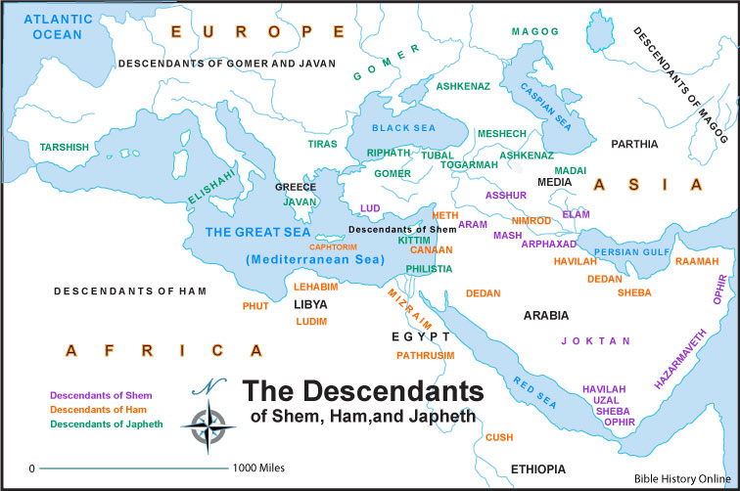

Slide 104
Looking back at the mitochondrial DNA map

Slide 105
What this means?
Genetic studies of mitochondrial DNA have determined three major “groups”.
After the flood, there were only three different types of mitochondrial DNA which would have been the seeds for the rest of the world.
The original nations after the flood appear to be loosely grouped according to family ties. The table of nations map looks very similar to the mitochondrial DNA map.
Why would the families of Noah’s sons generally stay together as they spread out after the flood?

Slide 106
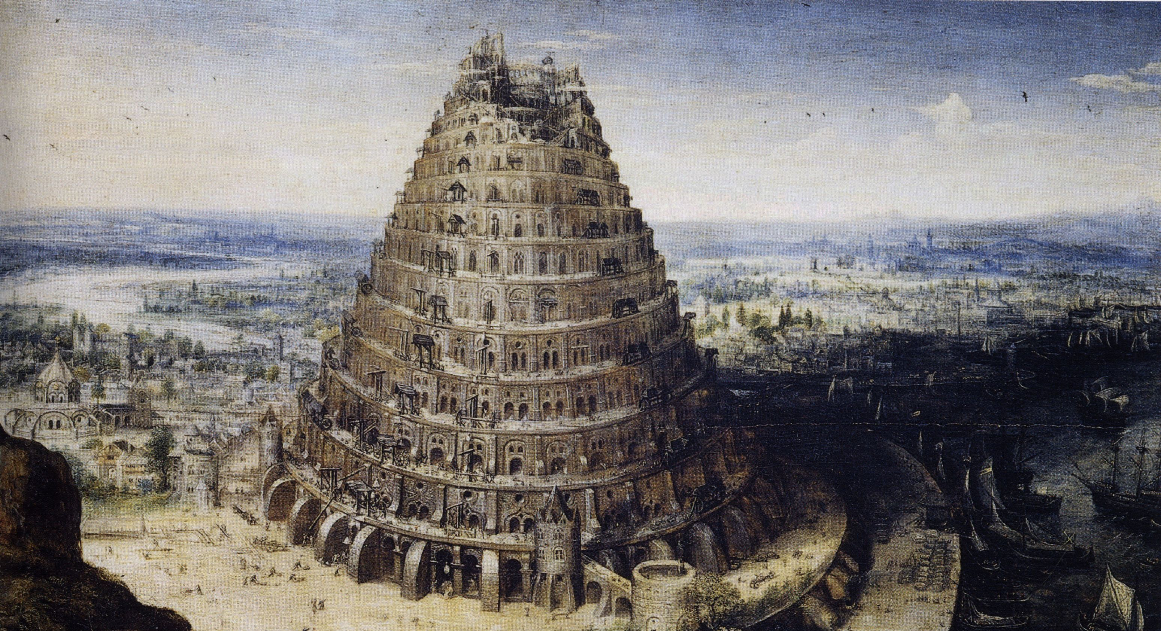
The tower of Babel

Slide 107
And now to the literature
As stated before, science can bring is to the conclusion life has been designed by some higher power.
Science cannot:
Determine the identity of this higher power
Determine how long this took
To answer these, we turn to the scriptures

Slide 108
Truth agreeing with truth
“Since the Holy Write is true, and all truth agrees with truth, the truth of the Holy Writ cannot be contrary to the truth obtained by reason and experiment.”
- The Authority of Scripture, Galileo Galilei
As we examine the scriptures we see a clear message – the Lord spoke the world into existence in six literal 24-hour days

Slide 109
Genesis 1
While reading the text, note the specific phrases used regarding each creative day as well as the order of creation.
Hebrew word for “day” is “yom”:
Can be used in the OT for single days or extended periods of time – context and the natural reading of the passage make the determination.
The phrase “the evening and the morning” place boundaries upon yom
The use of numerical designators (e.g., first day, second day, etc) are consistent with actual days when similar phrases are used in the OT (Numbers 29:7-38)

Slide 110
Genesis 1
The order of creation is very specific
Separation of light
Separation of waters
Plants on dry land
Heavenly bodies (first time the sun appears)
Fish and birds
All land creatures, including humans

Slide 111
Genesis 1
The natural reading of Genesis 1 is six consecutive days which were all literal 24-hour periods of time.
This is supported by God himself in Exodus 20:11, “For in six days the LORD made heaven and earth, the sea, and all that is in them, and rested on the seventh day. Therefore the LORD blessed the Sabbath day and made it holy.”

Slide 112
Alternate interpretations
Day-Age Theory
Gap Theory
“Segmented” Creation Theory
Theistic evolution

Slide 113
What if…
What if one of these interpretations is correct and the creation story, and even the story of Noah, was never meant to be taken literally?
What if the creation story was merely written in a way for people at the time to understand they came from God? It was allegorical because people at the time lacked the scientific knowledge we have now.
What if God is the Creator but has used evolution as the process rather than a six day creation?

Slide 114
Problems with the “what ifs”
Accepting these ideas alleviates struggle of the mind in trying to harmonize the scientific viewpoint of the earth’s age with the biblical concept that God created everything.
Multiple problems occur though once these premises are accepted.

Slide 115
God was misleading if not flat out lying
“For in six days the LORD made heaven and earth, the sea, and all that is in them, and rested on the seventh day. Therefore the LORD blessed the Sabbath day and made it holy.”
- Exodus 20:11

Slide 116
Other passages have to be ignored
Psalm 33:6 – “By the word of the LORD the heavens were made, and by the breath of his mouth all their host.”
Matthew 19:4-5 – “He answered, "Have you not read that he who created them from the beginning made them male and female, and said, 'Therefore a man shall leave his father and his mother and hold fast to his wife, and the two shall become one flesh'?” (Mark 10:6 reads similar)
Luke 3:38 – “the son of Enos, the son of Seth, the son of Adam, the son of God.”
Acts 17:26 – “And he made from one man every nation of mankind to live on all the face of the earth, having determined allotted periods and the boundaries of their dwelling place”
Romans 5:12-21 – Adam was a type of Jesus because by him sin came into the world and brought death to everyone

Slide 117
Other passages have to be ignored
I Corinthians 11:12 – “for as woman was made from man, so man is now born of woman. And all things are from God”
I Corinthians 15:22 – “For as in Adam all die, so also in Christ shall all be made alive”
I Corinthians 15:45 – “Thus it is written, ‘The first man Adam became a living being’; the last Adam became a life-giving spirit.”
I Timothy 2:13 – “For Adam was formed first, then Eve”
Hebrews 11:3 – “By faith we understand that the universe was created by the word of God, so that what is seen was not made out of things that are visible”
II Peter 3:5 – “For they deliberately overlook this fact, that the heavens existed long ago, and the earth was formed out of water and through water by the word of God”

Slide 118
And other passages regarding the flood?
Matthew 24:37-39 – “For as were the days of Noah, so will be the coming of the Son of Man. For as in those days before the flood they were eating and drinking, marrying and giving in marriage, until the day when Noah entered the ark, and they were unaware until the flood came and swept them all away, so will be the coming of the Son of Man.” (Similar passage in Luke 17:26-27)
Luke 3:36 – “the son of Cainan, the son of Arphaxad, the son of Shem, the son of Noah, the son of Lamech”
Hebrews 11:7 – “By faith Noah, being warned by God concerning events as yet unseen, in reverent fear constructed an ark for the saving of his household. By this he condemned the world and became an heir of the righteousness that comes by faith”

Slide 119
And other passages regarding the flood?
I Peter 3:20 – “because they formerly did not obey, when God's patience waited in the days of Noah, while the ark was being prepared, in which a few, that is, eight persons, were brought safely through water.”
II Peter 2:5 – ‘’if he did not spare the ancient world, but preserved Noah, a herald of righteousness, with seven others, when he brought a flood upon the world of the ungodly”
II Peter 3:6 – “and that by means of these the world that then existed was deluged with water and perished”

Slide 120
Other spiritual problems
If the Lord used evolution as the means of “creation” rather than six consecutive, literal days, then there are other spiritual issues:
At some point someone was born who had a soul and their parents did not
At some point God decided to hold an individual accountable to a law, and therefore the possibility of sin, and the parents were not accountable
Death existed in the world, specifically in the ancestors of humans before sin came into the world.
Romans 5:12-17
I Corinthians 15:21-22

